Slide 1

multiplex social network analysis with R
Matteo Magnani
InfoLab, Dept. of Information Technology
Uppsala University
http://infolab.it.uu.se @uuinfolab
matteo.magnani@it.uu.se @matmagnani
Luca Rossi
Networks, Data & Society
IT University of Copenhagen
http://nerds.itu.dk @nerdsitu
lucr@itu.dk @LR
^{This work was} partially supported by the European Community through the project “Values and ethics in Innovation for Responsible Technology in Europe” (Virt-EU) funded under Horizon 2020 ICT-35-RIA call Enabling Responsible ICT-related Research and Innovation.

Slide 2
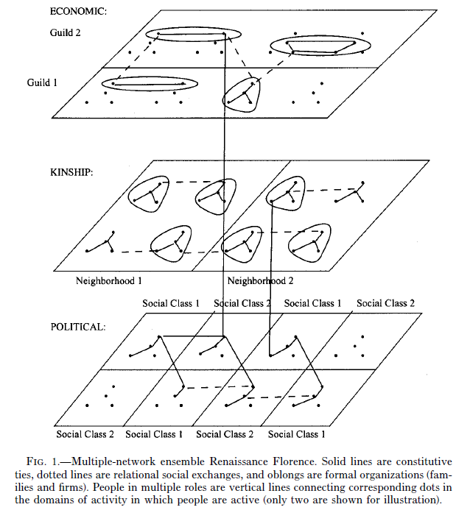
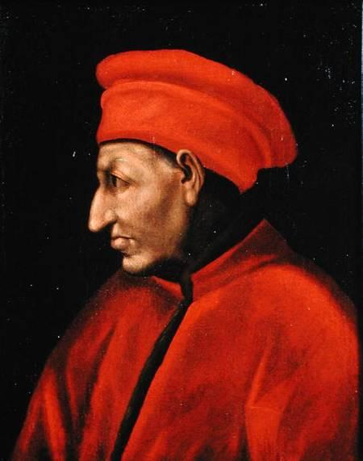
J F Padgett & P D McLean (2006) Organizational Invention and Elite Transformation: The Birth of Partnership Systems in Renaissance Florence. American Journal of Sociology Volume 111 Number 5
Moreno, J L. 1934. Who Shall Survive? A New Approach to the Problem of Human Interrelations.

Slide 3
Multiplex networks as multilayer networks
One actor
edge
vertex
Two edge types (layers)

Slide 4
Multiplex networks as multilayer networks
Multi-relational networks
(collaboration, leisure, bullying, knowledge exchange, …)
Connections on different social network platforms
(Twitter, YouTube, Facebook)
Different types of connections on the same platform
(follow, RT, reply, mention, like)
Topical conversational networks
(one topic per layer)
(see: Temporal Text Networks)

Slide 5
Goals for today
At the end of this workshop you should be able to:
Load multiplex network data.
Explore small multiplex networks.
Compare layers (that is, edge types).
Compute actor measures.
Discover and compare communities.
+ material, references

Slide 6
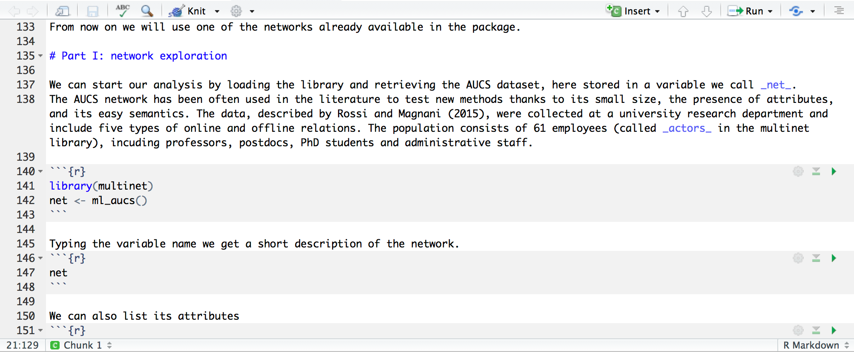
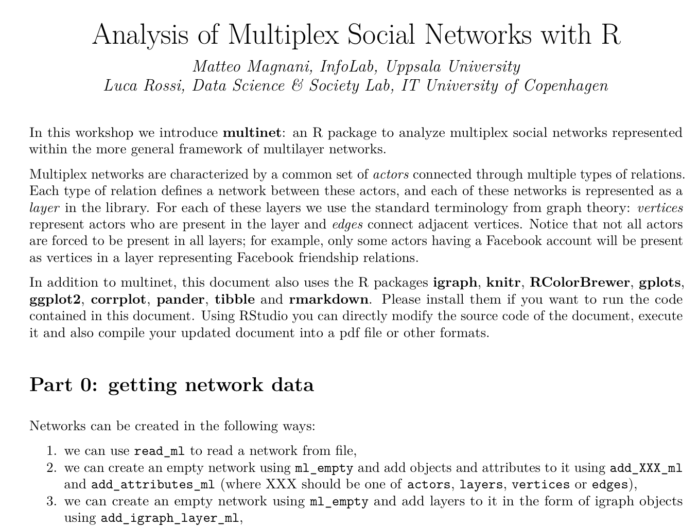
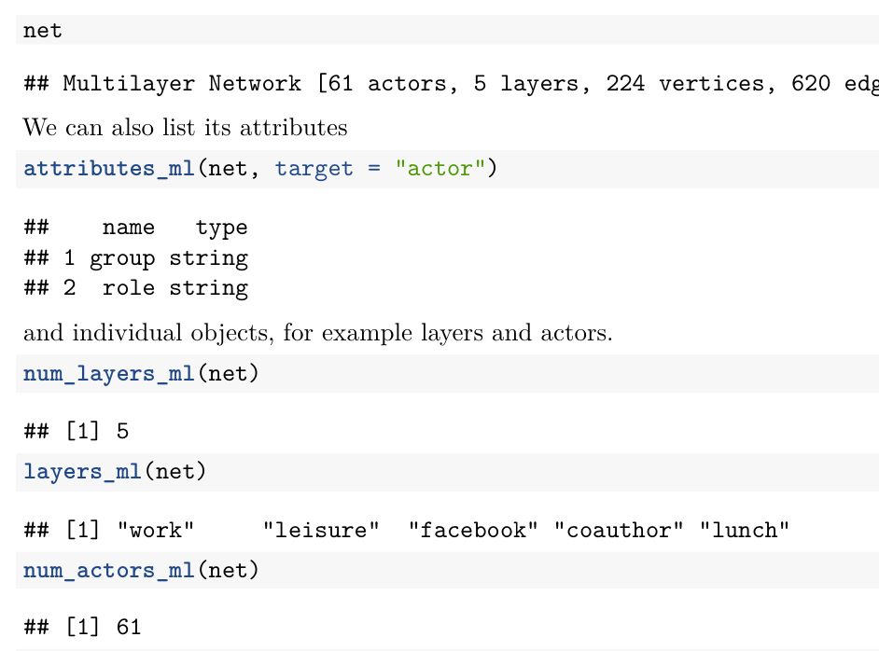
workshop.Rmd
workshop.pdf

Slide 7
About the uunet.multinet library
2011 ML-model [1]: started coding our own methods.
2016 Organized previous code to write our book [2].
2017 First version released on CRAN for R (mostly C++).
2021 Major code re-engineering based on multilayer cubes.
[1] Magnani & Rossi, 2011
[2] Dickison, Magnani & Rossi, 2016

Slide 8
Getting started
Part 0

Slide 9
Getting network data
Networks can be created in the following ways:
From an empty network: ml_empty()
Manually adding layers, vertices, edges, attributes.
Adding igraph graphs as layers.
Reading it from a file: read_ml()
Growing a synthetic network: grow_ml()
Loading a predefined network: ml_name()
aucs, florentine, sampson, bankwiring, tailorshop.

Slide 10
Getting network data
Networks can be created in the following ways:
From an empty network: ml_empty()
Manually adding layers, vertices, edges, attributes.
Adding igraph graphs as layers.
Reading it from a file: read_ml()
Growing a synthetic network: grow_ml()
Loading a predefined network: ml_name()
aucs, florentine, sampson, bankwiring, tailorshop.

Slide 11
Input file format (basic)
read_ml("file-name")
Matteo, Luca
Matteo, Davide
Luca, Matteo
Matteo, Luca, work
Matteo, Davide, work
Luca, Matteo, friendship
Davide
Davide
Matteo
Matteo
work
Luca
Luca
Matteo
friendship
Luca

Slide 12
Input file format (full)
#TYPE multiplex
#LAYERS
research, UNDIRECTED
twitter, DIRECTED
#ACTOR ATTRIBUTES
affiliation, STRING
Age, NUMERIC
#VERTEX ATTRIBUTES
twitter, num_tweets, NUMERIC
#EDGE ATTRIBUTES
research, num_publications, NUMERIC
#ACTORS
Luca,ITU,42
Matteo,UU,41
Davide,UU,37
#VERTICES
Luca,twitter,53
Matteo,twitter,13
#EDGES
Luca,Matteo,research,9
Davide,Matteo,research,7
Luca,Matteo,twitter
example.txt
?multinet.IO

Slide 13
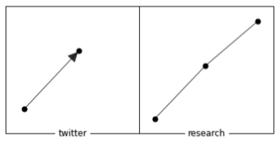
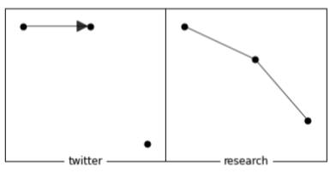
Aligned multiplex networks
n = read_ml("example.txt")
n = read_ml("example.txt", aligned = T)
the aligned = T parameter in the second call ensures that there is a vertex to each layer for every actor in the input file.

Slide 14
Things to remember
Simple network -> simple input file.
If you need directionality, attributes -> specific format.
Alignment! (Impact on analysis).

Slide 15
Getting an overview
Part 1

Slide 16
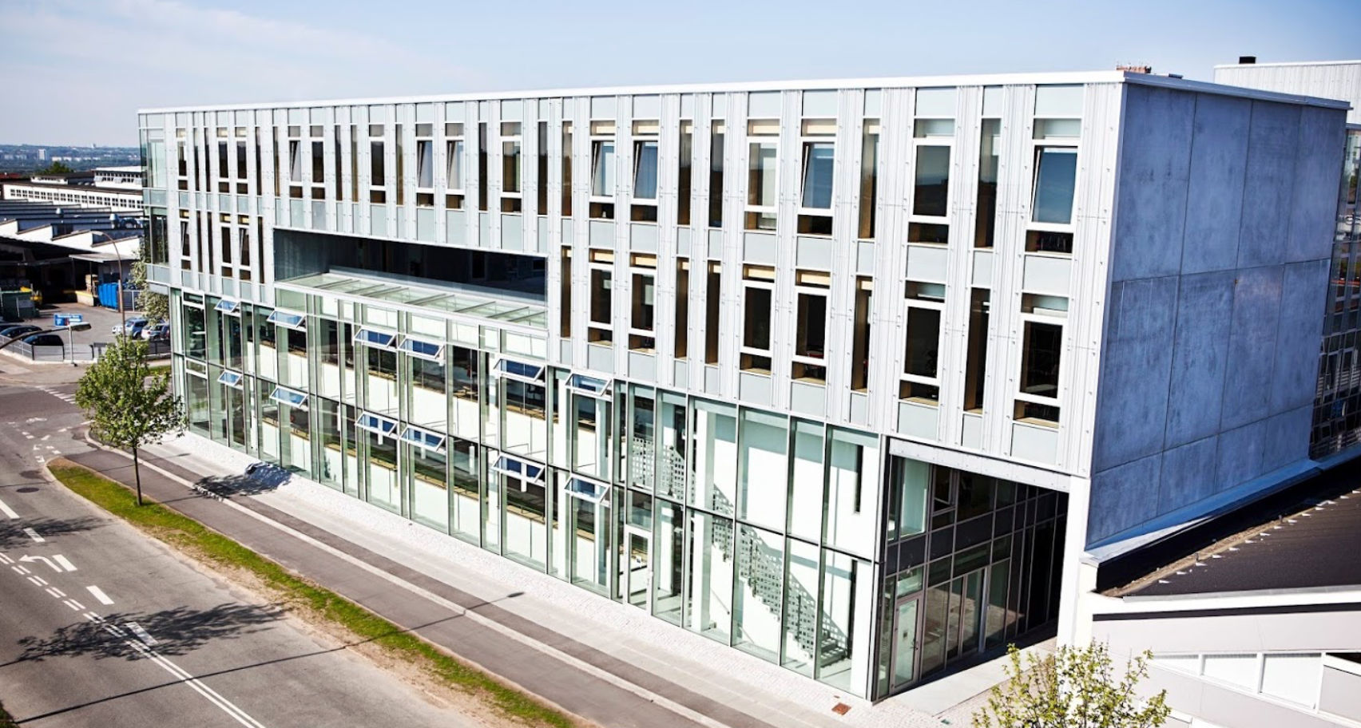
Our working example: AUCS
library(multinet)
net <- ml_aucs()
net
layers_ml(net)
actors_ml(net)
vertices_ml(net)
edges_ml(net)
attributes_ml(net, target = "actor")

Slide 17
Force-based layout
w_in
vertex repulsion
vertex attraction through edges
gravity
w_inter
w_in
vertex repulsion
vertex attraction through edges
gravity

Slide 18
Force-based layout
in
inter

Slide 19
A first visualization
plot(net)
l <- layout_multiforce_ml(net, w_inter = 0, gravity = 1)
plot( net,
vertex.labels = "", grid = c(2,3),
layout = l,
legend.x="bottomright”, legend.inset = c(.05,.05) )

Slide 21
Tasks
Plot the network coloring the vertices (actors) according to their role.
Observe and interpret the result. What are you learning about this network?
Do the same visualizing the research group instead of the role.

Slide 22
Plotting vertex attributes
vertices_ml(net)
vertices_ml(net)[[1]]
get_values_ml(…)
actor | layer
U49 | leisure
U142 | coauthor
U62 | leisure
U23 | leisure
U23 | lunch
actor
U49
U142
U62
U23
U23
value
PhD
PhD
Postdoc
PhD
PhD
#A6CEE3
#A6CEE3
#1F78B4
#A6CEE3
#A6CEE3

Slide 23
Plotting vertex attributes
role_attributes <- get_values_ml(net, actors = vertices_ml(net)[[1]], attribute = "role")
vertices_ml(net)
vertices_ml(net)[[1]]
get_values_ml(…)
actor | layer
U49 | leisure
U142 | coauthor
U62 | leisure
U23 | leisure
U23 | lunch
actor
U49
U142
U62
U23
U23
value
PhD
PhD
Postdoc
PhD
PhD

Slide 24
Plotting vertex attributes
role_attributes <- get_values_ml(net, actors = vertices_ml(net)[[1]], attribute = "role")
gr <- values2graphics(role_attributes)
gr$color
gr$legend.text
gr$legend.col
gr$legend.pch
value
PhD
PhD
Postdoc
PhD
PhD
#A6CEE3
#A6CEE3
#1F78B4
#A6CEE3
#A6CEE3
PhD
Postdoc
#A6CEE3
#1F78B4
21
21

Slide 25
Plotting vertex attributes
role_attributes <- get_values_ml(net, actors = vertices_ml(net)[[1]], attribute = "role”)
gr <- values2graphics(role_attributes[[1]])
plot( net,
layout = l,
grid = c(2,3),
vertex.labels = "",
vertex.color = gr$color
)
legend( "bottomright”,
legend = gr$legend.text,
col = gr$legend.col, pt.bg = gr$legend.col, pch = gr$legend.pch,
bty = "n", pt.cex = 1, cex = .5, inset = c(0.05, 0.05)
)

Slide 26
Roles

Slide 27
Research groups

Slide 28
Some final considerations
Multilayer network visualization is in its infancy, and will be a very active research sub-area in the near future (according to us).
If interested, look at what the visualization community is doing: McGee et al. (2019).
The approach presented above can be useful for small networks.
Otherwise we will need interactivity.
Later we cover network measures: these can also be visualized with traditional types of plots without plotting the network structure.

Slide 29
LAYER COMPARISON
Part 2

Slide 30
Summary statistics
Layers can be converted (individually or in groups) into igraph networks and analyzed independently of each others.
summary () provides a comparison of all the layers in an undirected multilayer network.
Before you execute summary():
What is the layer with highest density?
What is the layer with highest clustering coefficient?

Slide 31
Summary statistics
summary ()
 | N | M | Nc | dens | Cc | Apl | Dia
Flat | 61 | 620 | 1 | .33 | .48 | 2.06 | 4
Coauthor | 25 | 21 | 8 | .07 | .43 | 1.50 | 3
Facebook | 32 | 124 | 1 | .25 | .48 | 1.96 | 4
Leisure | 47 | 88 | 2 | .08 | .34 | 3.12 | 8
Lunch | 60 | 193 | 1 | .11 | .57 | 3.19 | 7
Work | 60 | 194 | 1 | .11 | .34 | 2.39 | 4

Slide 32
d <- degree_ml(net, layers = <layername>)
hist(d, breaks = max(d, na.rm = TRUE), main=<layername>, xlab="degree")

Slide 33
Layer measures
layer_comparison_ml () can be used to compute various types of multilayer specific comparisons (e.g. the presence of the same actor on multiple layers). layer_comparison_ml(net, method="jaccard.actors")
 | Facebook | Lunch | Leisure | Work | Coauthor
Facebook | 1 | .53 | .52 | .53 | .30
Lunch |  | 1 | .78 | .97 | .42
Leisure |  |  | 1 | .78 | .42
Work |  |  |  | 1 | .42
Coauthor |  |  |  |  | 1

Slide 34
Task: layer comparison
We will compute the following layer comparisons:
jaccard.actors
Higher if many actors are common.
pearson.degree
Higher if actors have high (resp., low) degree in both layers (“popular” actors are popular in both).
jaccard.edges
Higher if actors are adjacent to the same individuals in both layers.
coverage.edges
Percentage of edges in one layer that are also present in the other.

Slide 35
Task: layer comparison
layer_comparison_ml(net, method=“XXXXX”)
pearson.degree
Which pair of layers has the highest value?
Which pair of layers has the lowest value?
Is the lowest value negative?
coverage.edges
Which pair of layers has the highest value?
What highest value do you expect?

Slide 36
Pearson degree

Slide 37
Coverage edges

Slide 38
Actor analysis
Part 3

Slide 39
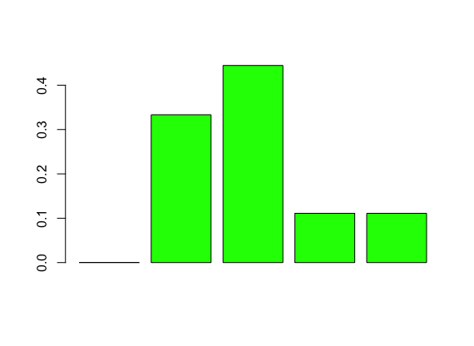
Degree
Degree of a vertex: number of adjacent edges.
2
1
4
2
2
2
1
3
1

Slide 40
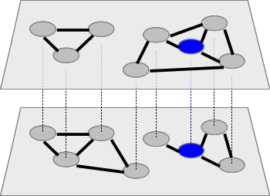
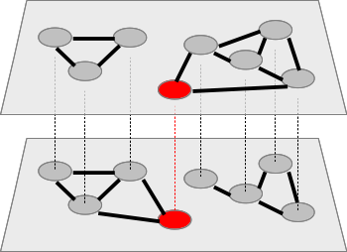
Degree and neighborhood
Degree: 3
Central
Degree: 2
Peripheral
Degree: 3
Central
Degree: 2
Peripheral
Neighbors: 3
Central
Neighbors: 4
Very central
neighborhood_ml
xneighborhood_ml

Slide 41
Task: find the “important” actors.
n <- neighborhood_ml(net)
top_values <- head( n[order(-n)] )
top_actors <- head( actors_ml(net)[order(-n)] )
n <- neighborhood_ml( net, layers = "leisure")
n <- xneighborhood_ml( net, layers = "leisure")
# You can also pass c("leisure", "work", …).
degree_deviation_ml(net, actors="U4")

Slide 42
Layer relevance
3 neighbors: relevance 100%
3 neighbors
2 neighbors: relevance 50%
4 neighbors
Notes:
What happens if I only KEEP

Slide 43
Exclusive neighbors
3 neighbors
0 x-neighbors
2 neighbors
2 x-neighbors

Slide 44
Exclusive layer relevance
3 neighbors: relevance 100%
0 x-neighbors
x-relevance: 0%
3 neighbors
2 neighbors: relevance 50%
2 x-neighbors
x-relevance: 50%
4 neighbors

Slide 45
Task: find and characterize the “important” actors.
Extract the actors with the most neighbors on the whole network.
Extract the actors with the most neighbors on each layer, or specific combinations of layers.
Given an actor, compute the relevance of each layer for this actor.

Slide 46
Task: find and characterize the “important” actors.
Extract the actors with the most neighbors on the whole network.
n <- neighborhood_ml(net)
n[order(-n)]
actors_ml(net)[order(-n)]
Extract the actors with the most neighbors on each layer, or specific combinations of layers.
neighborhood_ml( net, layers = "leisure")
Given an actor, compute the relevance of each layer for this actor.
relevance_ml( net, "U4", layers = "leisure")
xrelevance_ml( net, "U4", layers = "leisure")

Slide 47
Task: find and characterize the “important” actors.
n <- neighborhood_ml(net)
n[order(-n)]
actors_ml(net)[order(-n)]
neighborhood_ml( net, layers = "leisure")
relevance_ml( net, "U4", layers = "leisure")
xrelevance_ml( net, "U4", layers = "leisure")
# You can also pass c("leisure", "work", …).
degree_deviation_ml(net, actors="U4")

Slide 48
communities
Part 4

Slide 49
Agenda
A simple example (generalized Louvain).
An overview of the available algorithms.
Experiments.
Comparing results of different algorithms.
Testing different parameters.

Slide 50
A simple example (1)
The function glouvain_ml() uses the objective function defined by Mucha et al. (2010) to find community structures across layers, where vertices in different layers can belong to the same or a different community despite corresponding to the same actor.
clust = glouvain_ml(net)
 | actor | layer | cid
0 | U22 | lunch | 0
1 | U22 | coauthor | 0
2 | U22 | leisure | 0
3 | U22 | work | 0
4 | U26 | lunch | 0
... | ... | ... | ...

Slide 51
A simple execution
ml_clust <- glouvain_ml(net)
l <- layout_multiforce_ml(net)
plot( net,
com = ml_clust,
…)

Slide 52
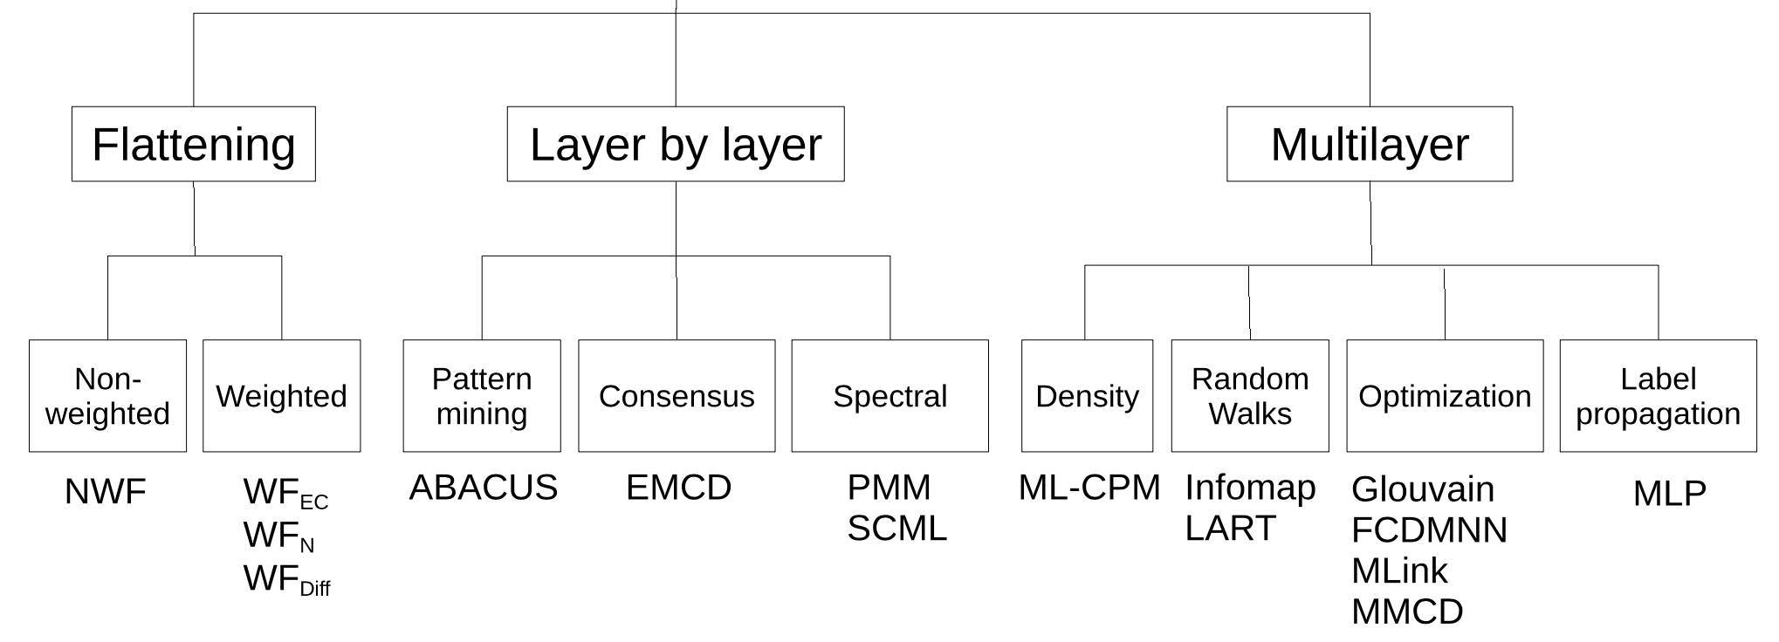
Available algorithms
Magnani et al., 2021

Slide 53
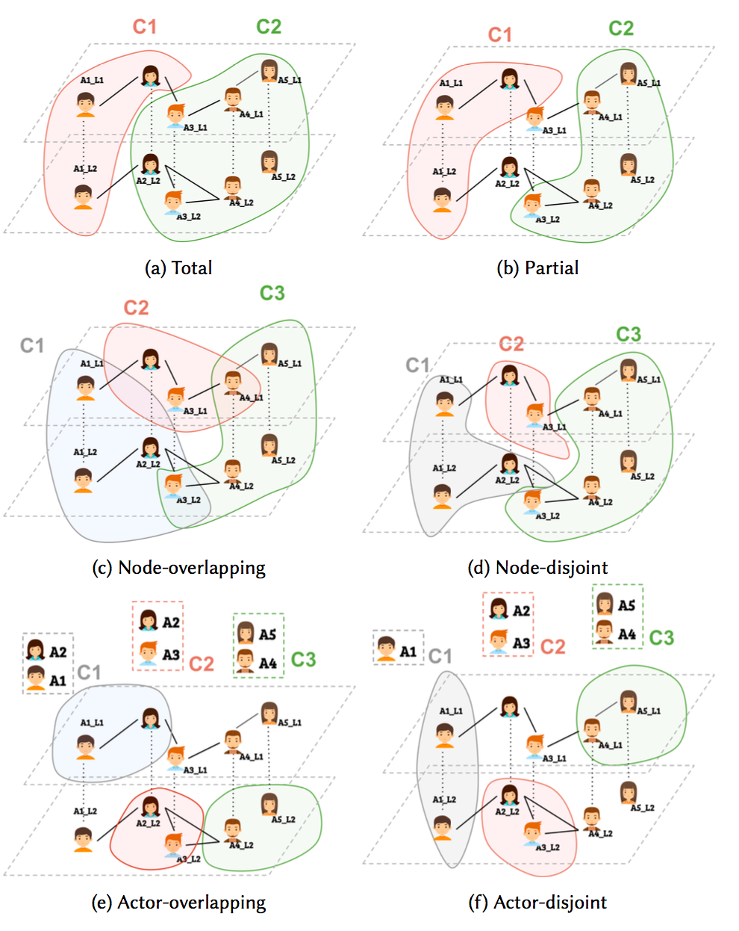

Slide 54
Available algorithms:
Name | Ref for ML version | Type
Multilayer clique percolation (ML-CPM) | Afsarmanesh and Magnani, 2018 | Overlapping, partial
ABACUS | Berlingerio et al., 2013 | Overlapping, partial
Infomap | De Domenico et al., 2015 | Partitioning or overlapping, undirected or directed networks
Generalized Louvain | Mucha et al., 2010 | Partitioning
Multi Dimensional Label Propagation | Boutemine and Bouguessa, 2017 | Partitioning
Flattening (weighted) | Berlingerio et al., 2011 | Partitioning (*)
Flattening (unweighted) | Berlingerio et al., 2011 | Partitioning (*)

Slide 55
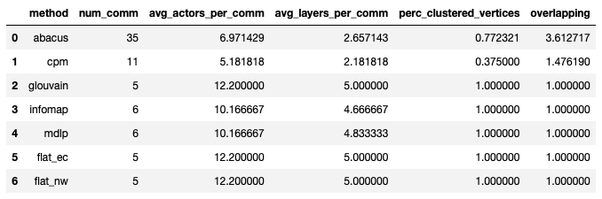
A comparison: statistics

Slide 56
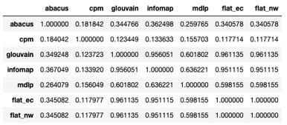
A comparison: omega index
nmi() also available, for partitioning methods

Slide 57
Back to generalized Louvain
Modularity is a clustering quality function introduced by Mark Newman in 2001.

Slide 58
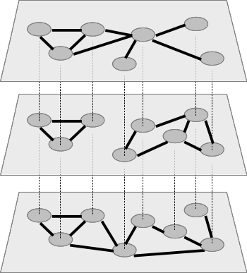
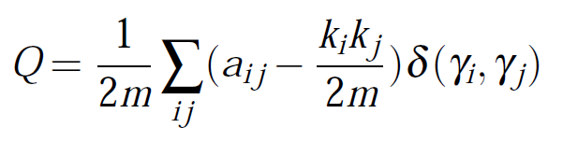
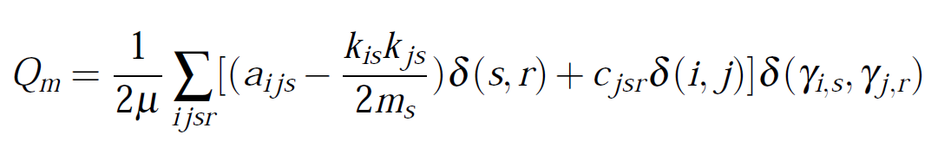
Multiplex modularity
nodes on same network
same node on different networks

Slide 59
A comparison: modularity
comm = glouvain_ml(aucs)
modularity_ml(net, comm)
0.5238050562810481
comm = mlpa_ml(aucs)
modularity_ml(net, comm)
0.4725328597429617
comm = infomap_ml(aucs)
modularity_ml(net, comm)
0.2558495527561328
comm = flat_ec_ml(aucs)
modularity(net, comm)
0.5218939280099651
comm = flat_nw_ml(aucs)
modularity_ml(net, comm)
0.5218939280099655

Slide 60
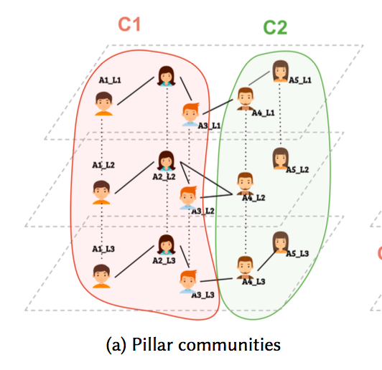
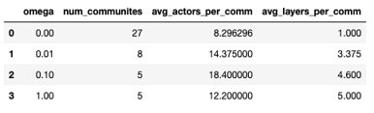
The results of gLouvain are highly dependent on the parameter omega: higher values will result in communities spanning multiple layers, because including the same actor on different layers in the same community increases the value of modularity. Omega = 0, having the same actors on different layers in the same community does not contribute to modularity.

Slide 61
Clique percolation method
Palla, Gergely, Imre Derényi, Illés Farkas, and Tamás Vicsek. 2005. “Uncovering the Overlapping Community Structure of Complex Networks in Nature and Society.” Nature 435 (7043).
Find max-cliques of size ≥ k
CPM(k)
Notes:
Contained

Slide 62
Clique percolation method
Find max-cliques of size ≥ k
CPM(k)

Slide 63
Clique percolation method
Adjacency: k-1 common nodes
CPM(k)

Slide 64
Clique percolation method
Find spanning trees (that is,
connected components)
CPM(k)

Slide 65
Clique percolation method
CPM(k)

Slide 66
Clique percolation method
CPM(k)

Slide 67
Clique percolation method
CPM(k)

Slide 68
Multiplex clique percolation method
CPM(k,m)

Slide 69
Network growing
Part 5

Slide 70
Why network generation?
An example: preferential attachment.
Some applications:
As a source of data, e.g., to test algorithms.
To reason about possible (simple) mechanisms explaining the observed structure of empirical networks (e.g., short average distance, hubs, …).
As a null model.
Multiplex networks are more complex:
Generating models must explain the internal structure of each layer + layer relationships.

Slide 71
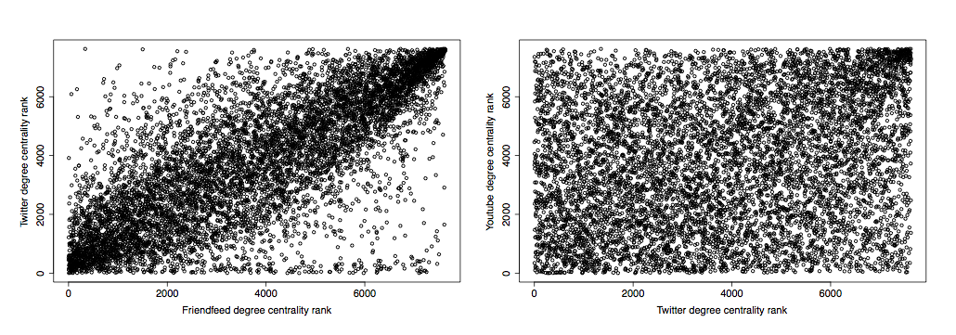


Some empirical evidence

Slide 72
The model in a nutshell
Internal-growth.
The layer grows according to internal dynamics, i.e., something happens independently of the other layers.
External-growth.
The layer grows according to external dynamics, i.e., something happens because of the configuration of an external layer.
No-action.
Nothing happens, i.e., the network remains unchanged.
Magnani and Rossi, 2013a.

Slide 73
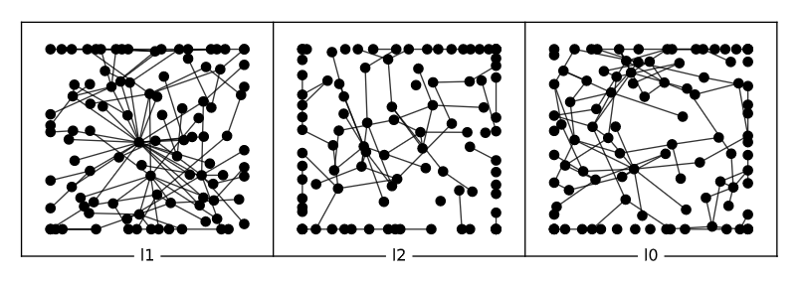
Network growing with multinet
models_mix <-
c(evolution_pa_ml(3,1), evolution_er_ml(100), evolution_er_ml(100))
pr.external <- c(0,.8,0) pr.internal <- c(1,.2,.8) dependency <- matrix(c(1,1,0,0,0,0,0,0,1),3,3)
Preferential attach.
Erdős–Rényi
Erdős–Rényi
100% internal growth
80% external
growth
100% internal growth
20% internal
growth

Slide 74
Network growing with multinet
ml_generated_mix <- grow_ml(
100,
100,
models_mix,
pr.internal,
pr.external,
dependency)

Slide 75
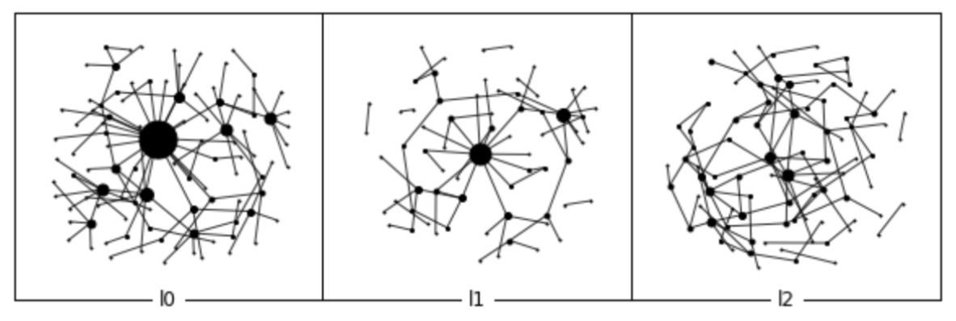
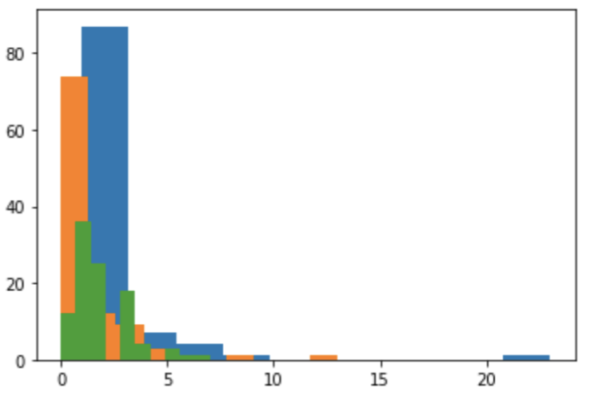
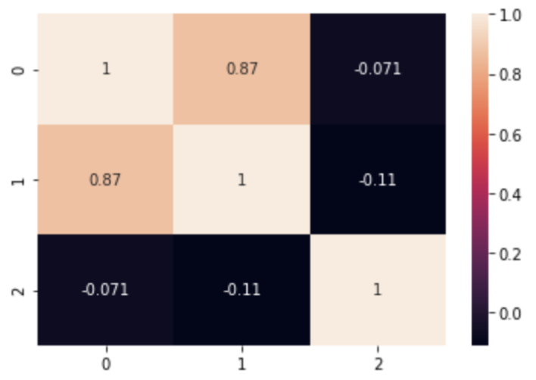
Result

Slide 76
Some take-home messages
Somehow unexplored topic.
It requires a lot of parameters.
Parameter estimation?
Other generation approaches (e.g., optimisation)?

Slide 77
References (1)
Afsarmanesh N, Magnani M (2018). “Partial and Overlapping Community Detection in Multiplex Social Networks.” In Social Informatics.
Berlingerio M, Coscia M, and Giannotti F.Finding and characterizing communities in multidimen- sional networks. In International Conference on Advances in Social Networks Analysis and Mining (ASONAM), pages 490–494. IEEE Computer Society Washington, DC, USA, 2011.
Berlingerio M, Coscia M, Giannotti F, Monreale A, Pedreschi D (2012). “Multidimensional Net- works: Foundations of Structural Analysis.” World Wide Web. ISSN 1386-145X.
Berlingerio M, Pinelli F, Calabrese F (2013). “ABACUS: Apriori-Based Community Discovery in Multidimensional Networks.” Data Mining and Knowledge Discovery, 27.
Boutemine O and Bouguessa M. “Mining Community Structures in Multidimensional Networks.” ACM Transactions on Knowledge Discovery from Data, 11(4):1–36, jun 2017. ISSN 15564681. doi: 10.1145/3080574.
Brodka P, Chmiel A, Magnani M, Ragozini G (2018). “Quantifying Layer Similarity in Multiplex Networks: A Systematic Study.” Royal Society open science, 5(8).
De Domenico M, Lancichinetti A, Arenas A, Rosvall M (2015). “Identifying Modular Flows on Mul- tilayer Networks Reveals Highly Overlapping Organization in Interconnected Systems.” Physical Review X, 5.
Dickison ME, Magnani M, Rossi L (2016). “Multilayer Social Networks.” Cambridge University Press. ISBN 978-1107438750.
Fatemi Z, Magnani M, Salehi M (2018). “A Generalized Force-Directed Layout for Multiplex Sociograms.” In Social Informatics.

Slide 78
References (2)
Interdonato R, Magnani M, Perna D, Tagarelli A, and Vega D, “Multilayer network simplification: Approaches, models and methods,” Computer Science Review, vol. 36, p. 100246, 2020, doi: 10.1016/j.cosrev.2020.100246.
Kivelä M, Arenas A, Barthelemy M, Gleeson JP, Moreno Y, Porter MA (2014). “Multi-layer Networks.” Journal of Complex Networks, 2(3), 203–271.
Magnani M, Rossi L (2011). “The ML-Model for Multi-layer Social Networks.” In ASONAM, pp. 5–12. IEEE Computer Society. ISBN 9781612847580.
Magnani M, Rossi L (2013a). “Formation of Multiple Networks.” In Social Computing, Behavioral- Cultural Modeling and Prediction, pp. 257–264. Springer-Verlag Berlin Heidel- berg. ISBN 978-3- 642-37209-4.
Magnani M, Rossi L (2013b). “Pareto Distance for Multi-layer Network Analysis.” In AM Green- berg, WG Kennedy, ND Bos (eds.), Social Computing, Behavioral-Cultural Mod- eling and Pre- diction, volume 7812 of Lecture Notes in Computer Science. Springer-Verlag, Berlin, Heidelberg. ISBN 978-3-642-37209-4.
Magnani M, Hanteer O, Interdonato R, Tagarelli A, Rossi L (2021). “Community Detection in Multiplex Networks.” ACM Computing Surveys, 54(3).
McGee F, Ghoniem M, Melançon G, Otjacques B, Pinaud B (2019). "The State of the Art in Multilayer Network Visualization." Computer graphics forum 38(6).
Moreno, J L. (1934). Who Shall Survive? A New Approach to the Problem of Human Interrelations
Mucha PJ, Richardson T, Macon K, Porter MA, Onnela JP (2010). “Community Structure in Time-Dependent, Multiscale, and Multiplex Networks.” Science, 328(5980), 876–878. ISSN 0036- 8075.

Slide 79
References (3)
J F Padgett & P D McLean (2006) Organizational Invention and Elite Transformation: The Birth of Partnership Systems in Renaissance Florence. American Journal of. Sociology, 111(5)
D. Vega and M. Magnani, “Foundations of Temporal Text Networks,” Applied Network Science, vol. 3, no. 1, p. 25, 2018, doi: 10.1007/s41109-018-0082-3.

Slide 80

Mikko Kivelä, Alexandre Arenas, Marc Barthelemy, James P. Gleeson, Yamir Moreno, and Mason A. Porter. 2014. “Multilayer Networks.” Physics and Society. Journal of Complex Networks 2 (3).
Stefano Boccaletti, Ginestra Bianconi, Regino Criado, Charo I. Del Genio, Jesús Gómez-Gardeñes, Miguel Romance, Irene Sendiña-Nadal, Zhen Wang, and Massimiliano Zanin. 2014. “The Structure and Dynamics of Multilayer Networks.” Physics Reports 544 (1).
Ginestra Bianconi. Multilayer Networks: Structure and Function. Oxford University Press. 2018.
Surveys on specific topics:
(on diffusion/propagation) Mostafa Salehi, Rajesh Sharma, Moreno Marzolla, Matteo Magnani, Payam Siyari, and Danilo Montesi. 2015. “Spreading Processes in Multilayer Networks.” IEEE Transactions on Network Science and Engineering 2 (2): 65–83.
(on layer comparison) Brodka, P., Chmiel, A., Magnani, M., and Ragozini, G. 2018. “Quantifying layer similarity in multiplex networks: a systematic study“. Royal Society Open Science, 5(8).
(on clustering) Obaida Hanteer, Roberto Interdonato, Matteo Magnani, Luca Rossi and Andrea Tagarelli, 2021. “Community Detection in Multiplex Networks.” ACM Computing Surveys, 54(3).
Bothorel, C., Cruz, J., Magnani, M., & Micenková, B., 2015. Clustering attributed graphs: models, measures and methods. Network Science, 3(3), 408-444. doi:10.1017/nws.2015.9
(on simplification) Roberto Interdonato, Matteo Magnani, Diego Perna, Andrea Tagarelli and Davide Vega, 2020. Computer Science Review, vol. 36, p. 100246, doi: 10.1016/j.cosrev.2020.100246.
http://multilayer.it.uu.se
Other R libraries: RSiena, multiplex

